Slide 1


Enron North America
Finance Business Analysis
& Reporting
Report Date- November 30, 2000
Confidential

Slide 2
Finance Business Analysis & Reporting
Project Objective:
Our review was designed to identify and test key policies, procedures, and controls related to 1) the FLASH, MPR, and accounting records are reconciled on a quarterly basis, 2) deals are documented and properly captured in the accounting records, 3) accounting information is complete and accurate, 4) proper access and security prevents unauthorized users and helps to ensure data integrity, 5) critical data is protected from unauthorized modification and misuse.
AA Team Members: Enron Team Members:

Slide 3
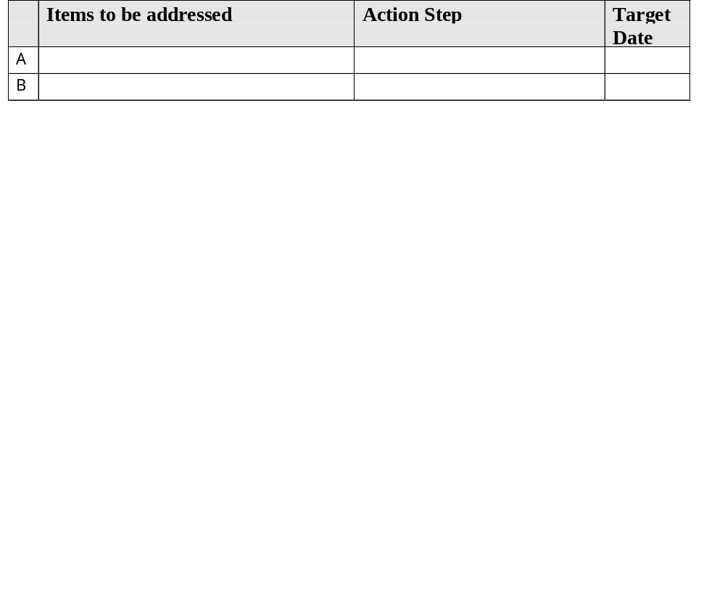
Finance Business Analysis & Reporting Observations

Slide 4
Finance Business Analysis & Reporting

